Slide 1

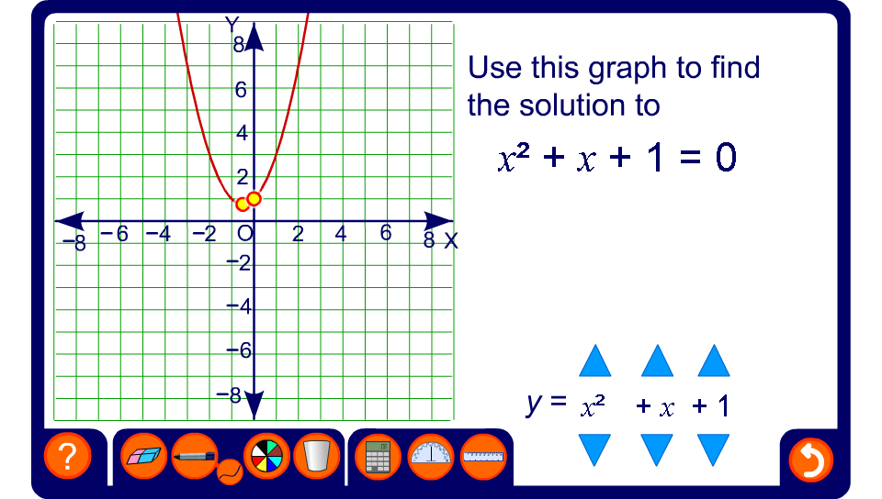


Demonstrating solutions using graphs
Notes:
Use this activity to demonstrate graphically the solutions to quadratic equations that factorize and do not factorize.
Reveal the coordinates of the points that intersect the x-axis and relate these to the solution of the equation.
Establish that without the use of a computer or a graphics calculator this is not an accurate method of solving the equation. For a more accurate solution we need to use an algebraic method. It is useful, however, for demonstrating the nature of the solutions, for example where there is only one solution, or no solutions.
The use of graphs to solve equations in covered in more detail in A9.3

